Slide 1
GuideSurfing
Lisa De Laurentiis
Niina Gromov
Stefanie Hofeman
Johanna Immonen
Bo Pang
Junqing Song

Slide 2
Agenda
Our service in a nutshell
Storyboard
Customer benefits
Initial customer study
Main differentiation from competitors
Technology

Slide 3
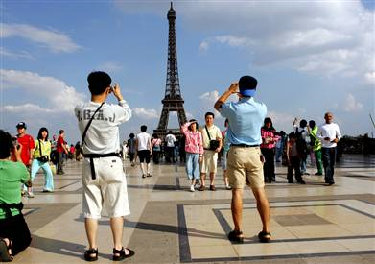
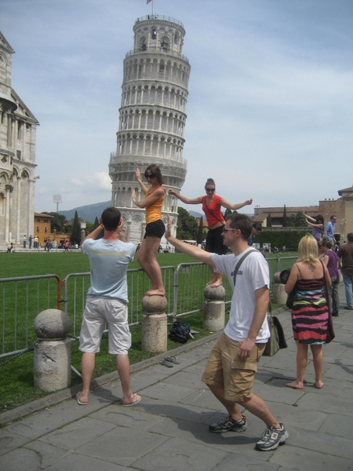
Background for the service
The death of mass tourism!
Self-organized trips becoming more common
Tourists are interested in experiences

Slide 4
1. Our service in a nutshell
Travellers want to meet local people
Local people want to meet travellers
Connecting them through GUIDE SURFING
→ Sharing experiences

Slide 5
2. Manual storyboard

Slide 6
3. Customer benefits
For the guided
Get to know the culture
Discover interesting places
For the guides
Meet new people
Get to know other cultures
Meet new people
Practice languages
Affect the image of your city and culture
Company for activities
Company for activities

Slide 7
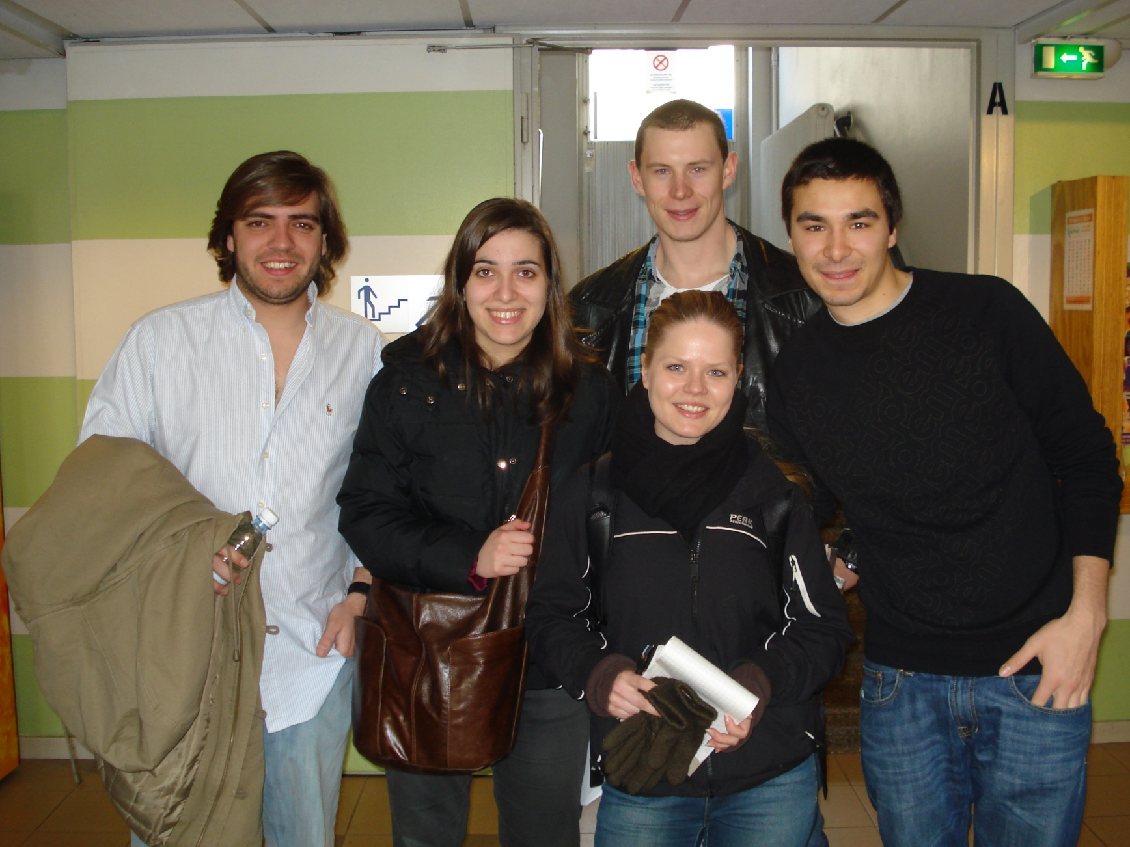
4. Initial customer study

Slide 8
4. Interviews with...
Helsinki Info
Eurohostel
Young people ask for local experiences
Do-it-yourself travelling more popular →taking the 3T tram instead of sightsee-bus
People come quite prepared, they sometimes request brochures in advance from the Info
They wish to get directions and fun facts
Different needs: architecture students, party people, shoppers
Lots of DIY travellers
Questions about restaurants, Finnish food, bars, discos
A. Aalto fans are also interested in Espoo
Also interest to cruise boats to Stockholm and Tallinn

Slide 9
4. Interviews with the tourists/students
Interviews with tourists from China, Greece, Belgium, Portugal
Chinese were heading to the Stockholm boat...
All wished they’d met some locals on their trip
Information, new friends, new places, new experiences
The ones who had were happy about it and felt they had experienced more that way

Slide 10
5. Differentiation
COMPETITORS
MAINS DIFFERENTIATOR
Couch Surfing (accommodation)
Couch Surfing is mainly for accommodation, no guarantee that hosts spend time witht their guests
Our service focuses on guidance
Guidance
Access to local actitivities
Guidebooks offer one-sided information on main tourist attractions
Our service provides access to experiencing local life & interesting places with a guide who shares your interests
Guide books
(general guidance)
Guided activities
(many types of tours)
Guided activities often designed to suit many tastes
Our service is based on interaction between the local and the tourists
Interactive activities
OUR SERVICE DIFFERS FROM EXISTING SERVICES

Slide 11
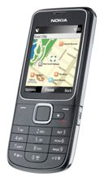
6. Technology Platform
Technologies to be used:
Python- Django Framework + MySQL
FaceBook API
Google Map API
Recommendation System (Content Filtering Technology)
Laptop / PC
( browser)
GuideSurfing-Server
MOBILE
(browser)

